Slide 1

Self
Introduction
by : Ansily Chiu District 31

Slide 2
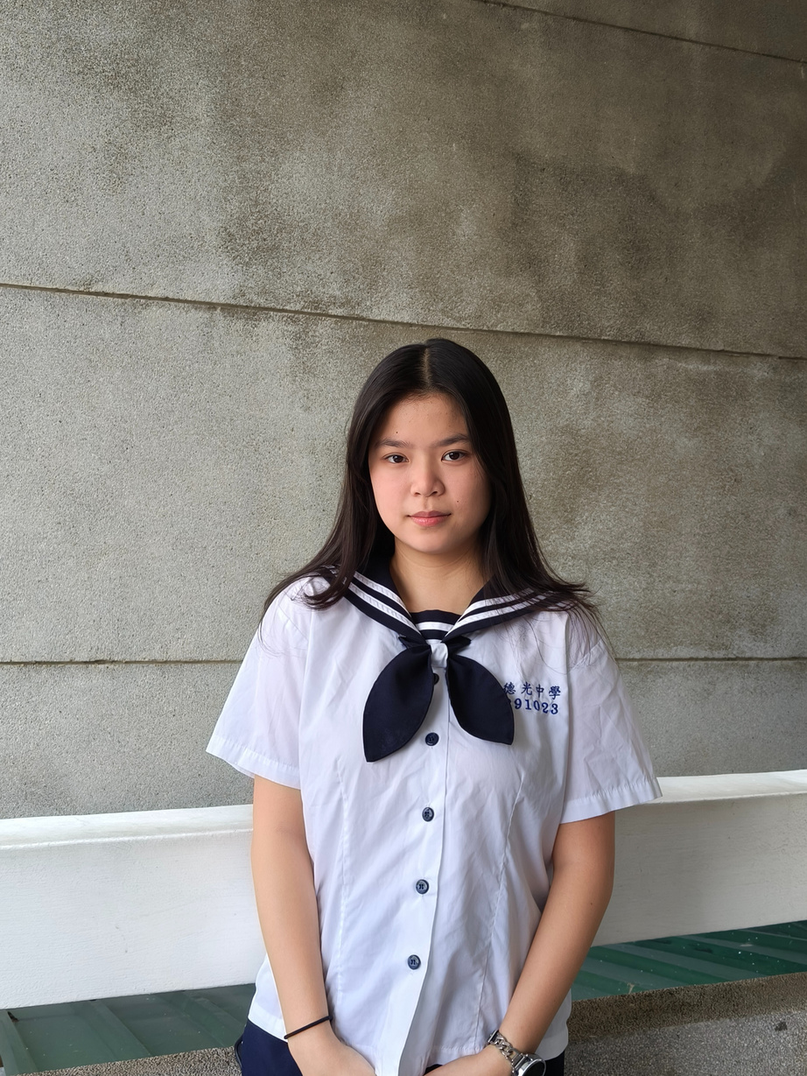

Hello
Im Ansily Chiu,
I'm an 11th-grade student from District 31, Taiwan, and a Z club leader at Deguang High School.
I've been with Deguang's Z club for 5 years now, and during these years, our club has participated in the "Love Binti" program by selling handmade cookies. We've also led historical camps in elementary schools.
When I joined Z club, I realized that even though we are just students, there is still more that we can do that meets our purpose.

Slide 3
Balancing
Beauty & Health
by : Ansily Chiu District 31

Slide 4

Body Insecurity
What causes Body Insecurity and Body Shaming?
Celebrities? Pretty clothes? Latest fashion trend?
How does social media affect a woman's mind on perfect figures?
How have society's expectations of women's figures in Asia changed in recent years?

Slide 5

Body Insecurity
What does Body Insecurity bring?
Dissatisfied with their appearance
Psychological stress
Eating disorders
Depression
Distorted self-perception
Self-harming behaviors
Unnecessary dieting
Low self-esteem

Slide 6



Connect with SDGs
You are the best, and no one can judge your figure.
SDG3
“Good Health and Well-being”.
“Reducing non-communicable diseases and promoting mental health."
SDG5
“Achieve Gender Equality and Empower All Women and Girls”.
“Ending discrimination against women and girls.”

Slide 7

As Zontians, we can…
Creating videos, animations, or infographics and promoting them on Zonta’s social media.
Organize speeches and panel discussions in schools and communities.
Host themed fairs to educate people on healthy eating, balanced exercise, and mental well-being.
Raise funds through events to support those who are affected by bulimia or body image struggles, offering counseling and recovery resources.

Slide 8

Health should always be first
Everyone is beautiful in their own unique way.
The pursuit of beauty should not come at the expense of health but based on confidence, acceptance, and a balanced lifestyle.

Slide 9

Imagine a future where Asian women are no longer pressured by body insecurities but shine because of their strong physicality, stable mental states, and great self-confidence.

Slide 10


