Slide 1
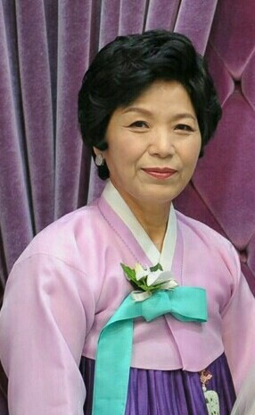

District 32 Activity Report
Hyo Sook La
Governor, District 32
ZONTA INTERNATIONAL DISTRICT 32

Slide 2
District 32
379 members & 21 clubs as of Dec. 2024
Decreasing members due to aging
(As of 2024.12.31.)
(As of 2024.12.31.)
Division | Club Ⅰ | Club Ⅱ | Club Ⅲ | Club Ⅳ | Club Ⅴ | Club Ⅵ | Club Ⅶ | Club Ⅷ | Total
Area 1 Members | 20 | 10 | 25 | 7 | 16 | 1 | 19 | 9 | 107
Area 2 Members | 29 | 36 | 20 | 20 | 16 | 28 | 12 |  | 161
Area 3 Members | 23 | 14 |  | 21 |  | 10 | 29 | 14 | 111

Slide 3
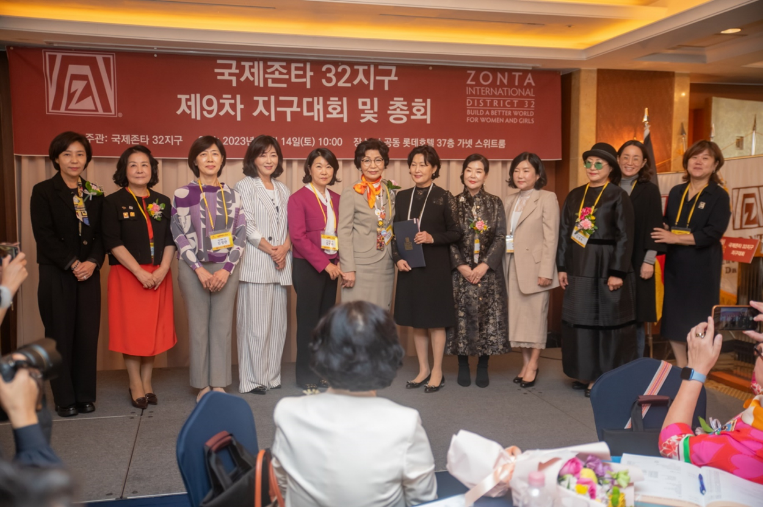
New membership strategy (1)
Zontian Award for contributing to securing members
2 or more new members
Awarded to those who have been maintained for more than 2 years
(12 recipients)

Slide 4
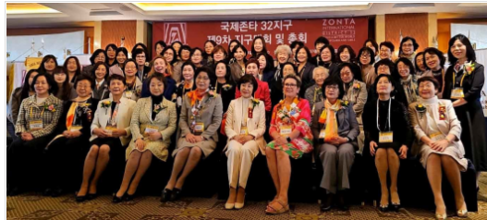
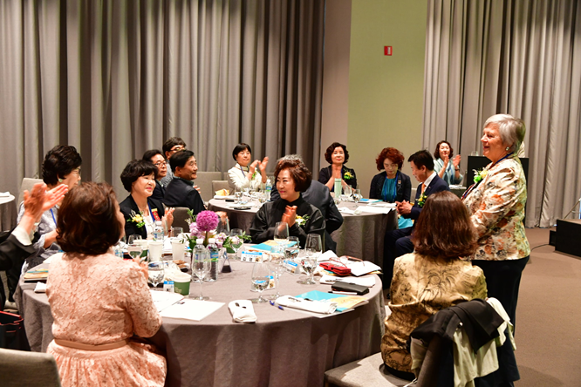
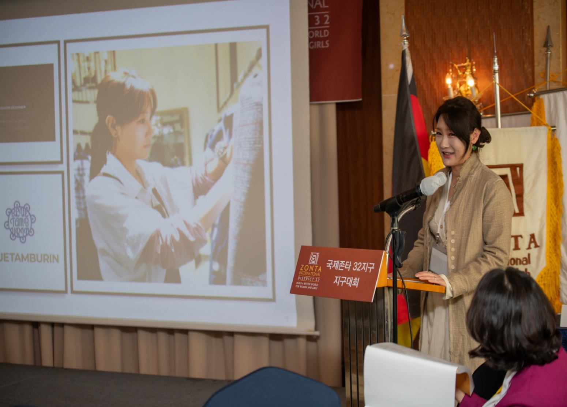
New membership strategy (2)
Inviting prospective members to district and regional conventions
<2023 District Convention>
<2024 Area Convention>

Slide 5
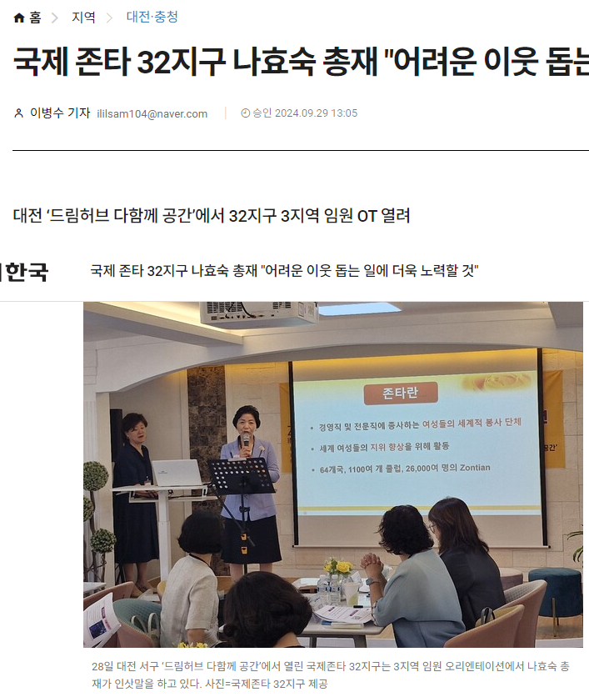
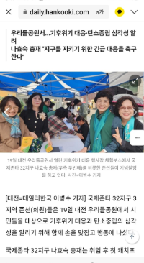
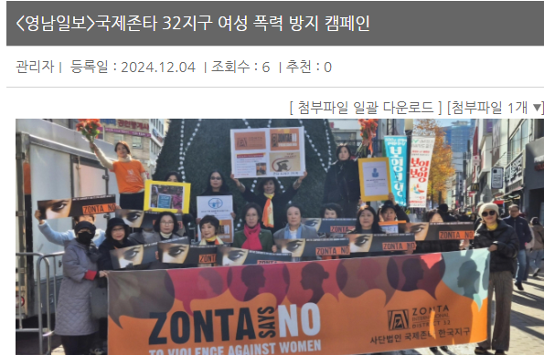
New membership strategy (3)
Active media promotion of all Zonta activities
<Orientation>
<Embracing a Green Earth>
<Zonta Says NO>

Slide 6
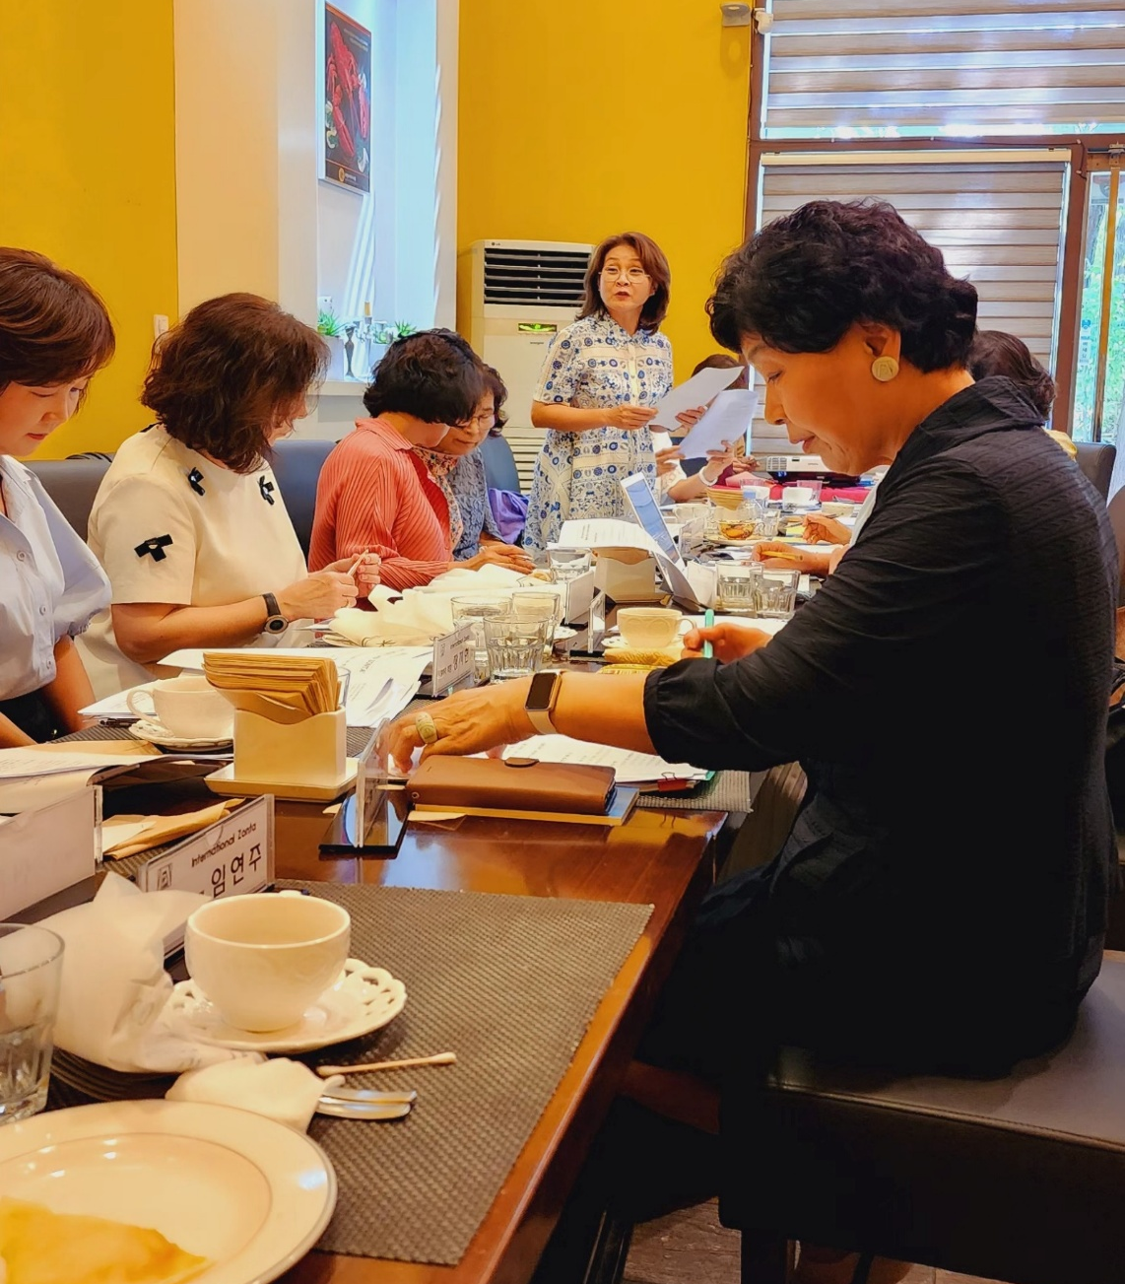
District 32 new start
Board Meeting Hosting
Date | 2024. 8. 31 (Sat.)
Location | Daejeon Mannyeondong (Hans Lobster)
Attendees | 7 Directors
Details | Report on the attendance of the 66th World Convention Activities and plans for the biennium Role of Directors

Slide 7
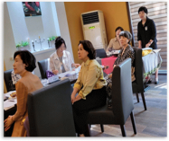
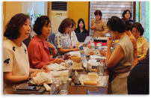
District 32 new start
Committee Hosting
Date | 2024. 8. 31 (Sat.)
Location | Daejeon Mannyeondong (Hans Lobster)
Attendees | A total of 20 members from each commitee
Details | Activities and plans for the biennium Information on each committee role Announcing the committee’s action plan

Slide 8
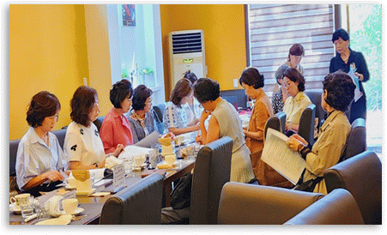
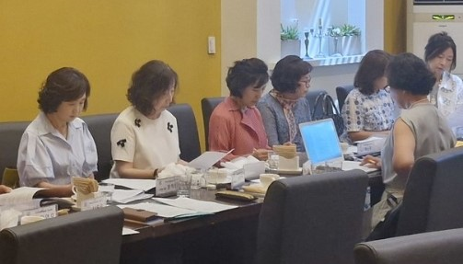
District 32 new start
Directional Sharing

Slide 9
Orientation Holding
Orientation Hosting
Division | Area 1 | Area 2 | Area 3
Date | 2024. 10. 5 (Sat.) | 2024. 9. 2 (Mon.) | 2024. 9. 28 (Sat.)
Location | Seoul | Daegu | Daejeon
Attendees | President of each area and each club. Secretary. Treasurer
Details | Report on the attendance at the 66th World Convention Information on the roles of executives District business plan and schedule information Promotion of the 3rd Asian Inter-District Meeting and the 67th World Convention

Slide 10
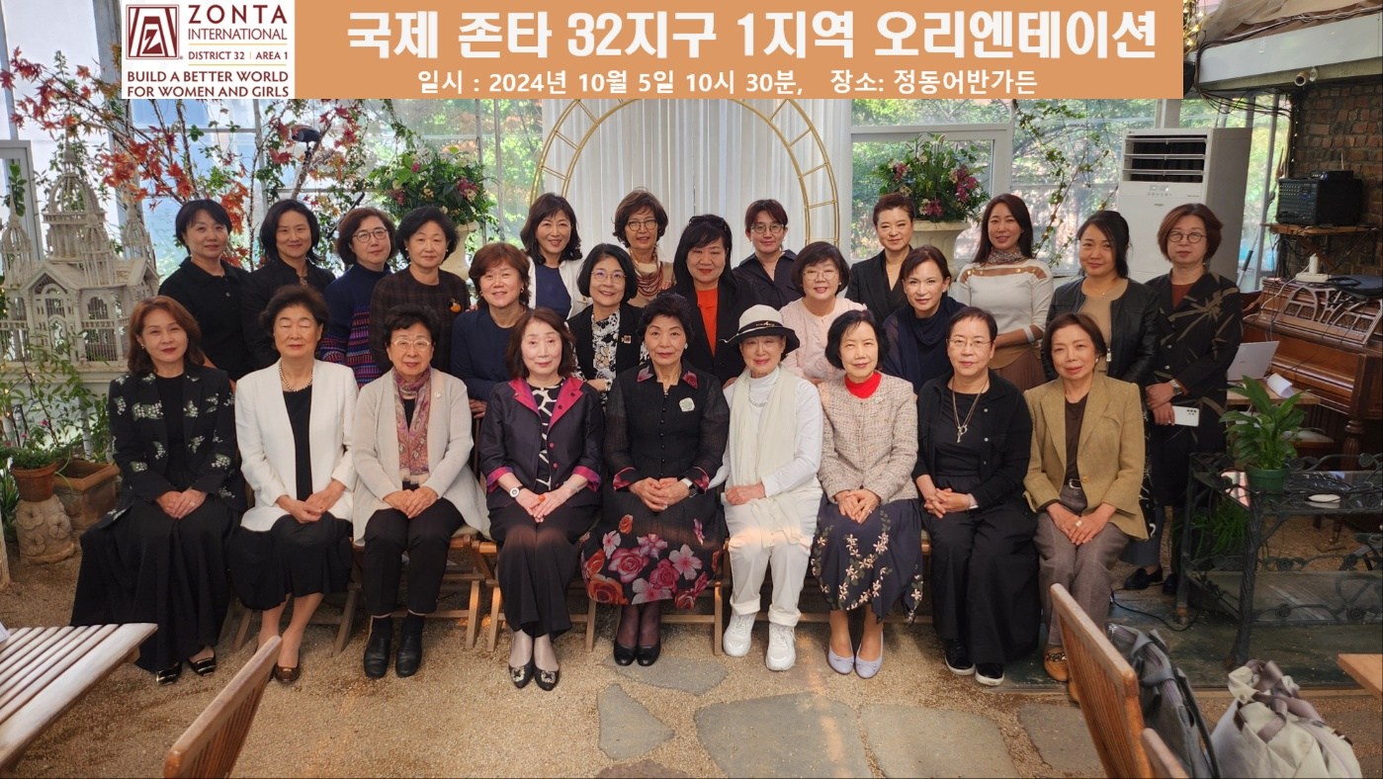
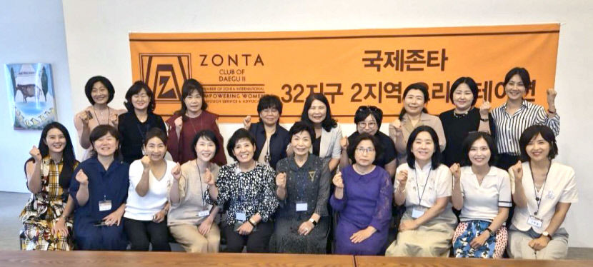
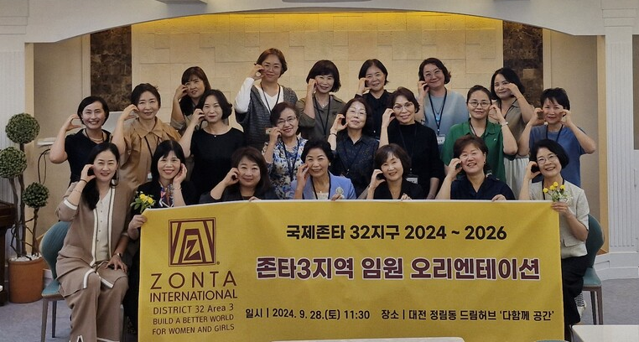
Orientation Holding
<Area 1: Seoul>
<Area 2: Daegu>
<Area 3: Daejeon>

Slide 11
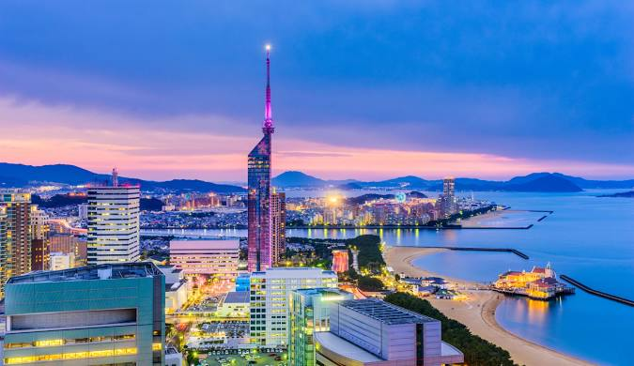

Orientation Holding
Asian Inter-District Meeting
Zonta International Conference
<JAPAN>
<CANADA>

Slide 12
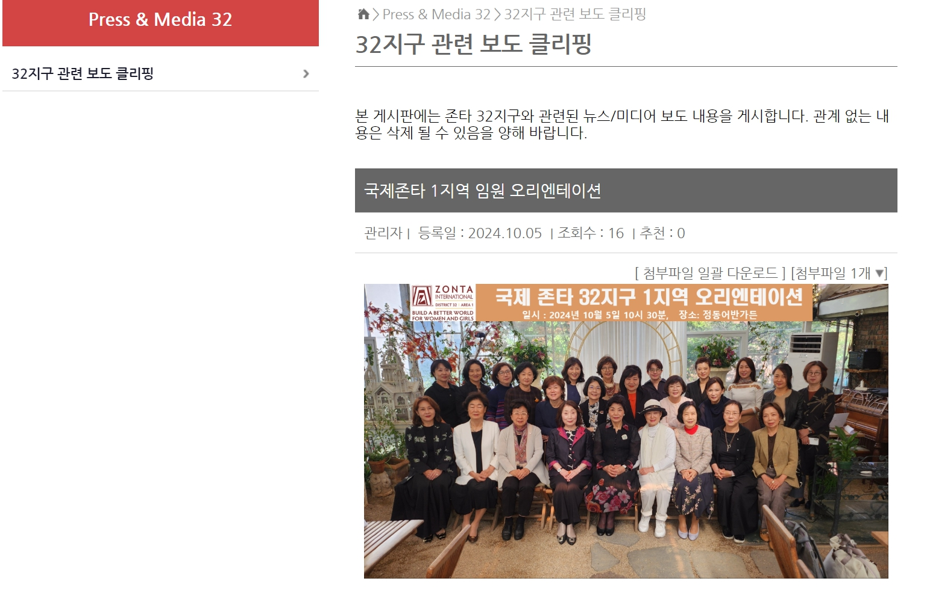
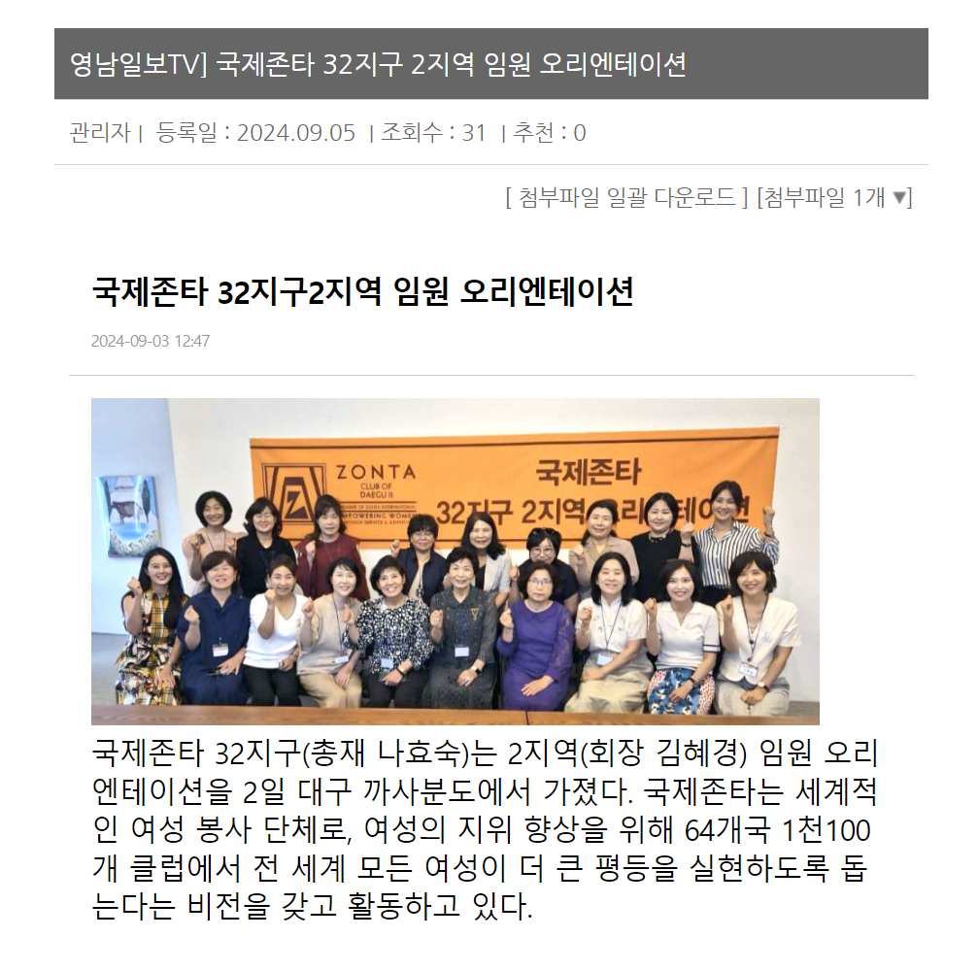
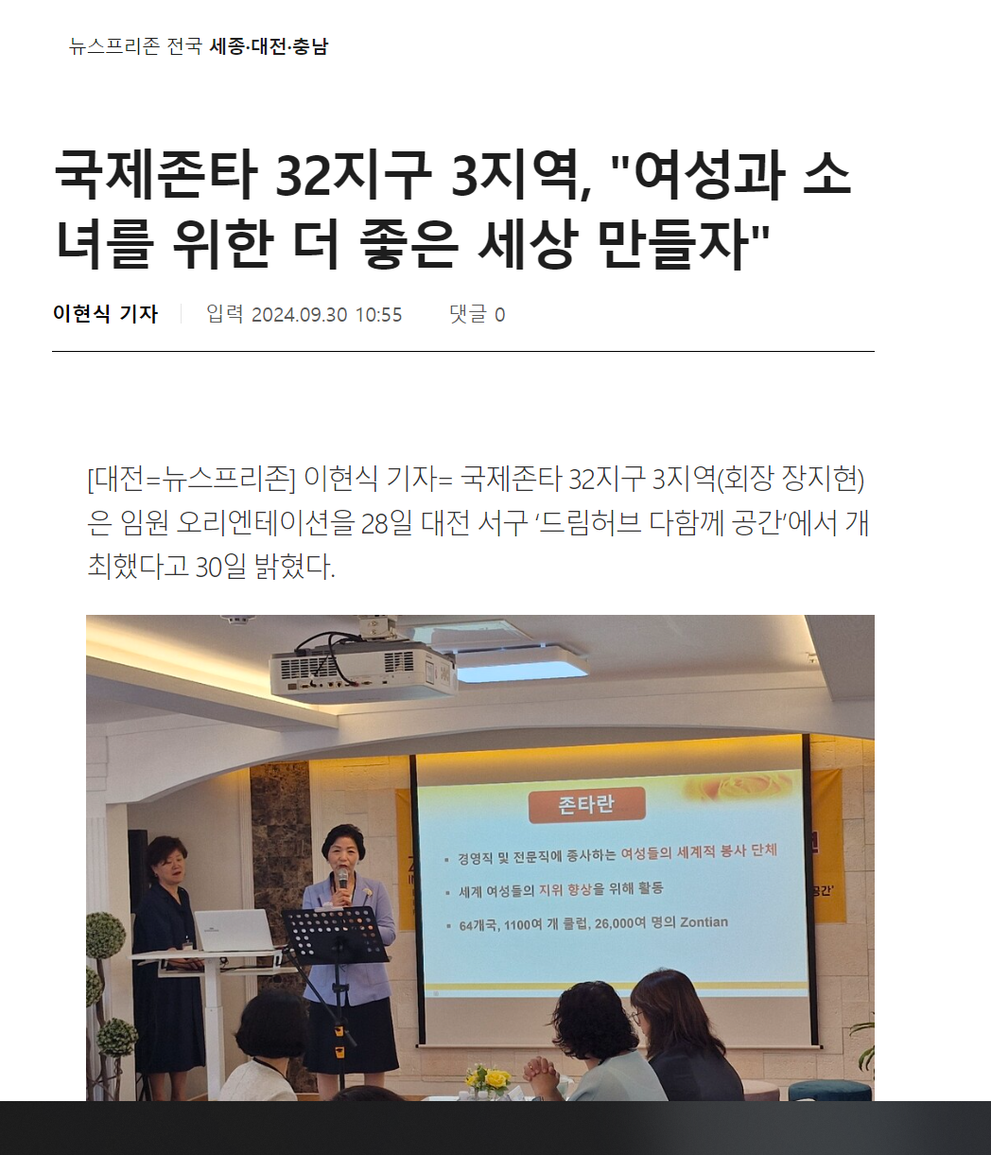
Orientation held: Media, sns - Promotion
<Area 1 Press Release>
<Area 2 Press Release>
<Area 3 Press Release>

Slide 13
1. embrace a green earth-with zonta
CLIMATE CRISIS RESPONSE EVENT - ADVOCACY (1)
Division | Area 1 | Area 2 | Area 3
Date | 2024. 10. 19 (Sat.) | 2024. 10. 19 (Sat.) | 2024. 10. 19 (Sat.)
Location | Seoul | Daegu, Busan | Daejeon, Yeosu
Attendees | 13 | 72 | 46
Details | Launching an eco-friendly campaign to overcome the climate crisis and achieve carbon neutrality Panel exhibition emphasizing the need to respond to the climate crisis Distribution of leaflets containing action guidelines for responding to the climate crisis

Slide 14
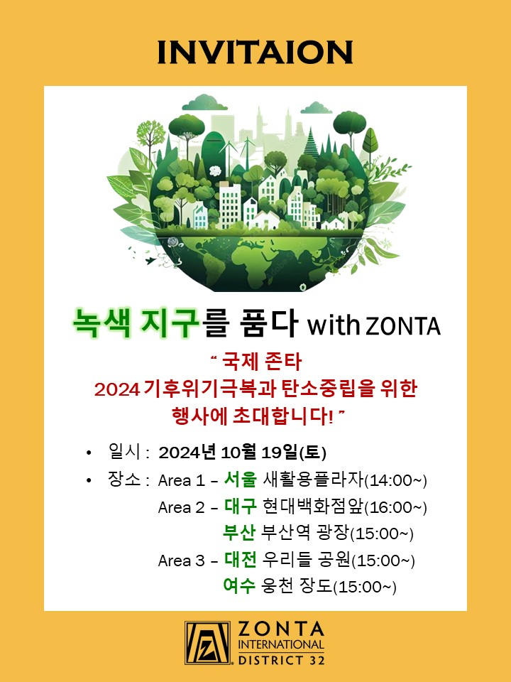

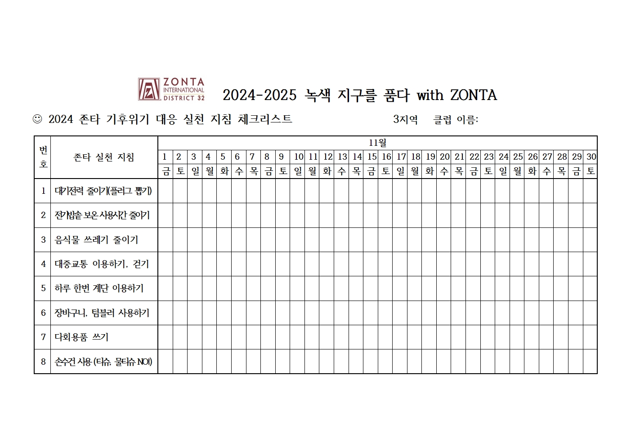
Activity materials
<Mobile Invitation>
< Banner>
< Checklist>

Slide 15

Activity materials
2024-2025 Green Earth with ZONTA
Embrace A Green Earth with Zonta Practice Guidelines Area ( ) Name:
# | Zonta Practice Guidelines | 11월
 |  | 1 | 2 | 3 | 4 | 5 | 6 | 7 | 8 | 9 | 10 | 11 | 12 | 13 | 14 | 15 | 16 | 17 | 18 | 19 | 20 | 21 | 22 | 23 | 24 | 25 | 26 | 27 | 28 | 29 | 30
 |  | F | S | S | M | T | W | T | F | S | S | M | T | W | T | F | S | S | M | T | W | T | F | S | S | M | T | W | T | F | S
1 | Reducing Energy (Unplugging)
2 | Reducing Rice Cooker Warming Function
3 | Reducing Food Waste
4 | Utilizing Public Transportation, Walking
5 | Utilizing Stairs (Once A Day)
6 | Utilizing Baskets, Tumblers
7 | Utilizing Reusable Products
8 | Reducing Paper Products (Tissue, Wet Wipes)

Slide 16

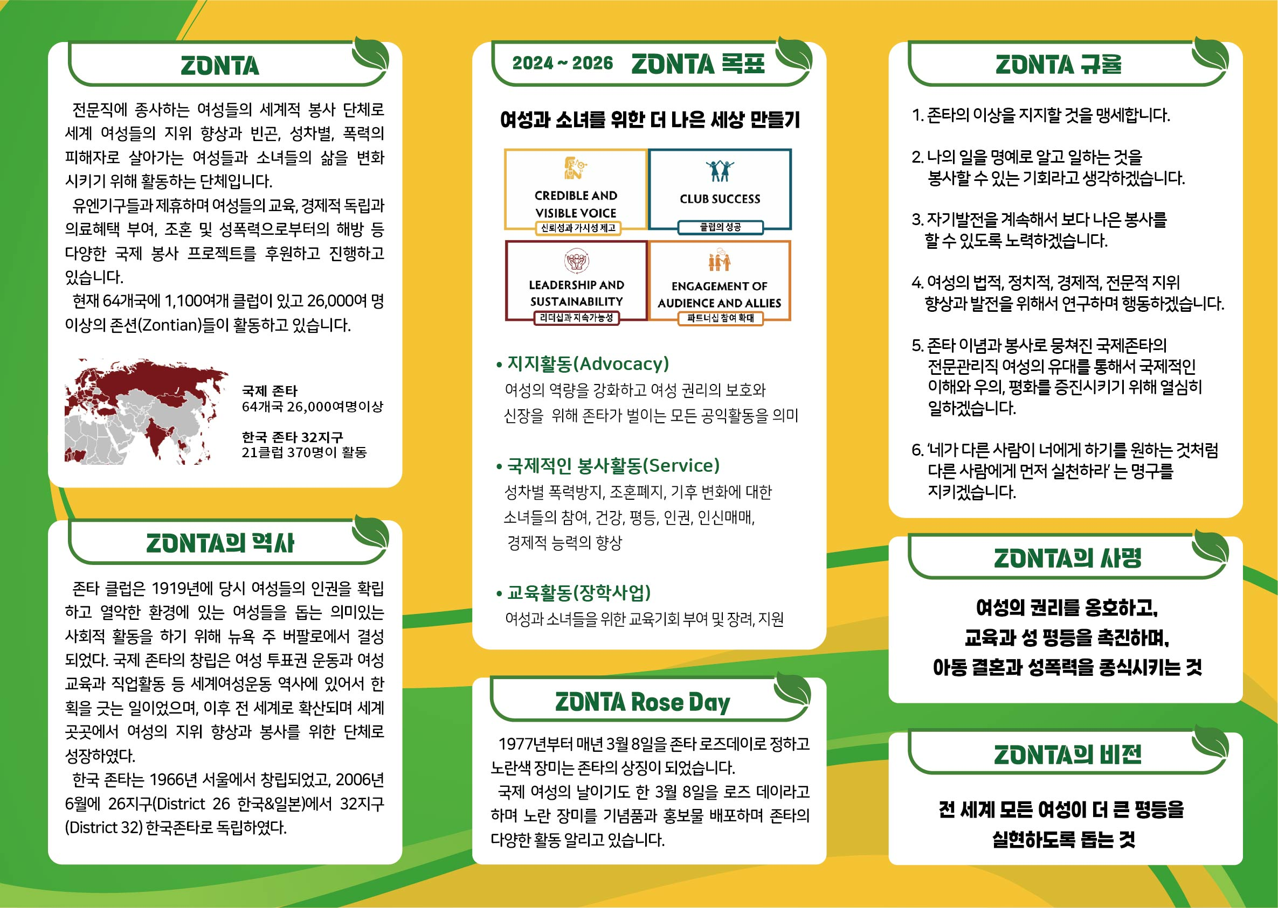
ACTIVITY MATERIALS
<Leaflet>

Slide 17
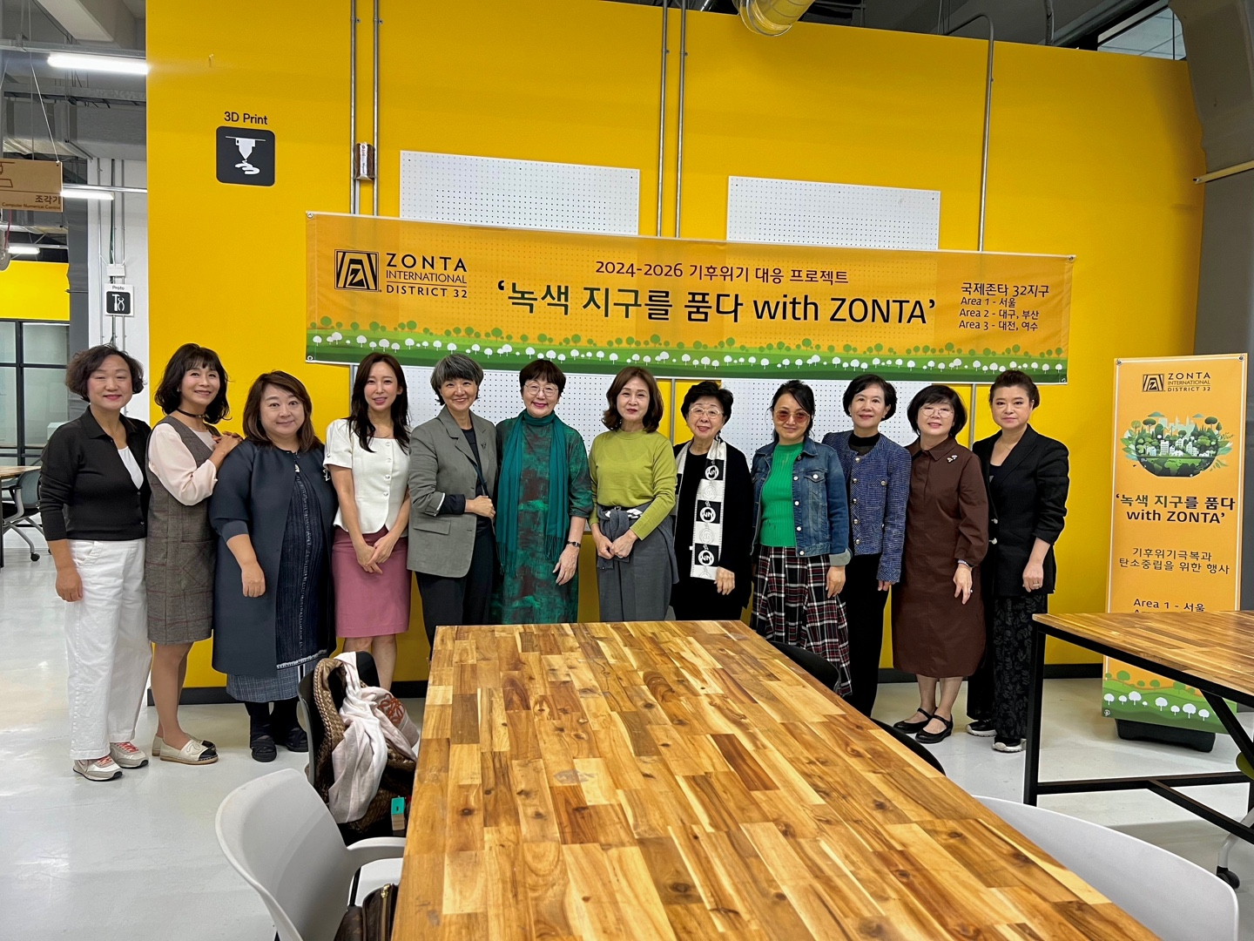
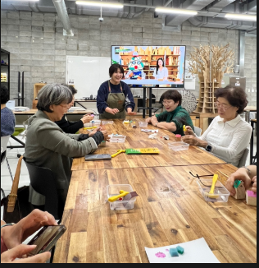
CLIMATE CRISIS RESPONSE EVENT
Region 1: Seoul (works using waste leather scraps)

Slide 18
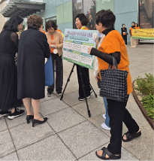
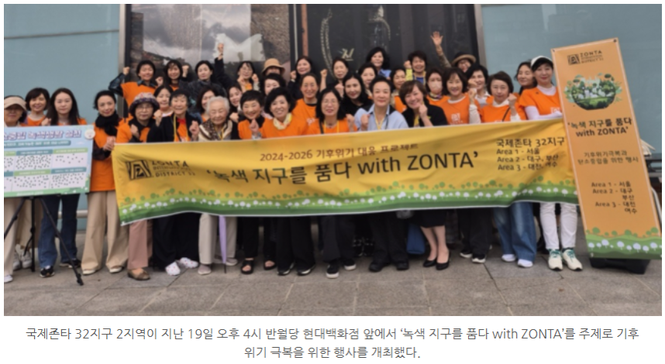
CLIMATE CRISIS RESPONSE EVENT
Region 2: Daegu (attach action sticker)

Slide 19
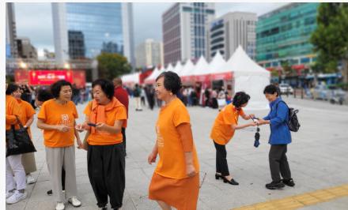
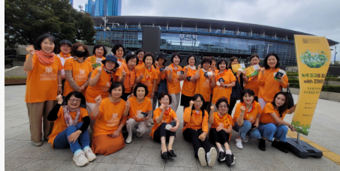
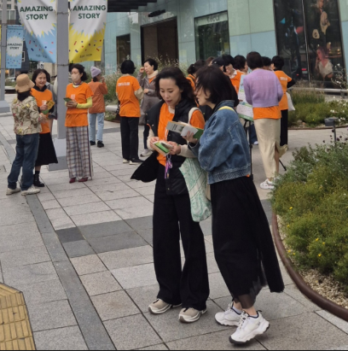
CLIMATE CRISIS RESPONSE EVENT
Region 2: Busan (leaflet distribution)

Slide 20
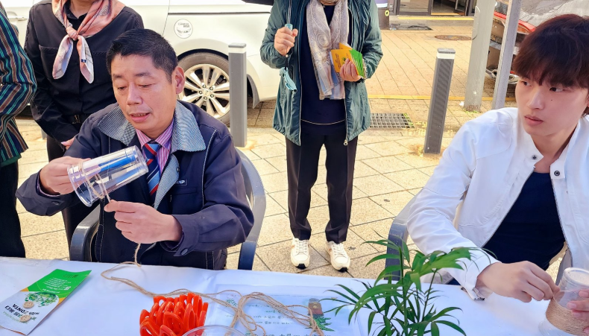
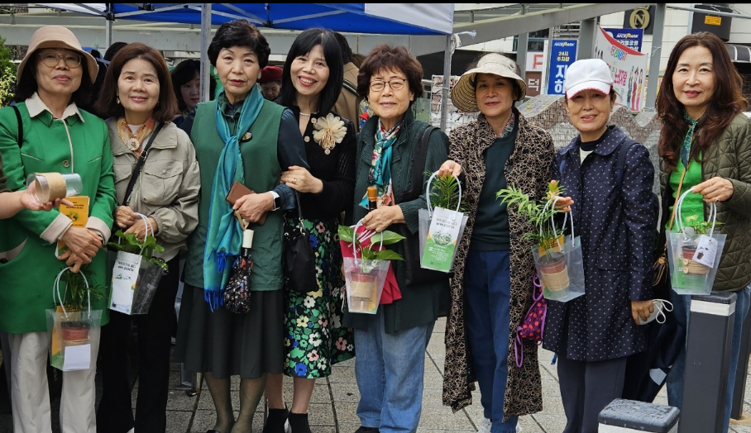
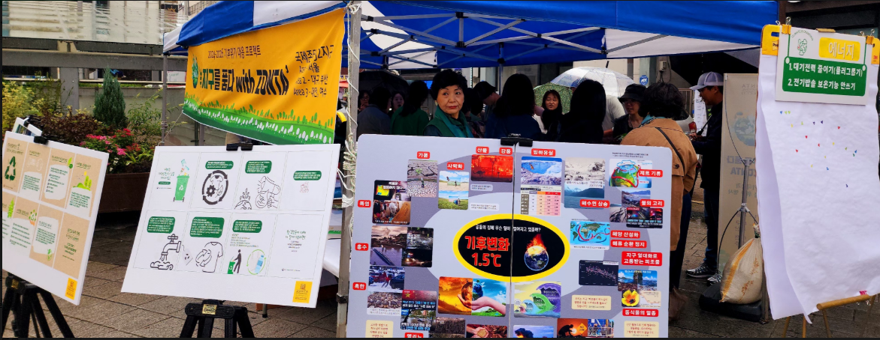
CLIMATE CRISIS RESPONSE EVENT
Region 3: Daejeon(flower pot making experience for carbon neutrality)

Slide 21
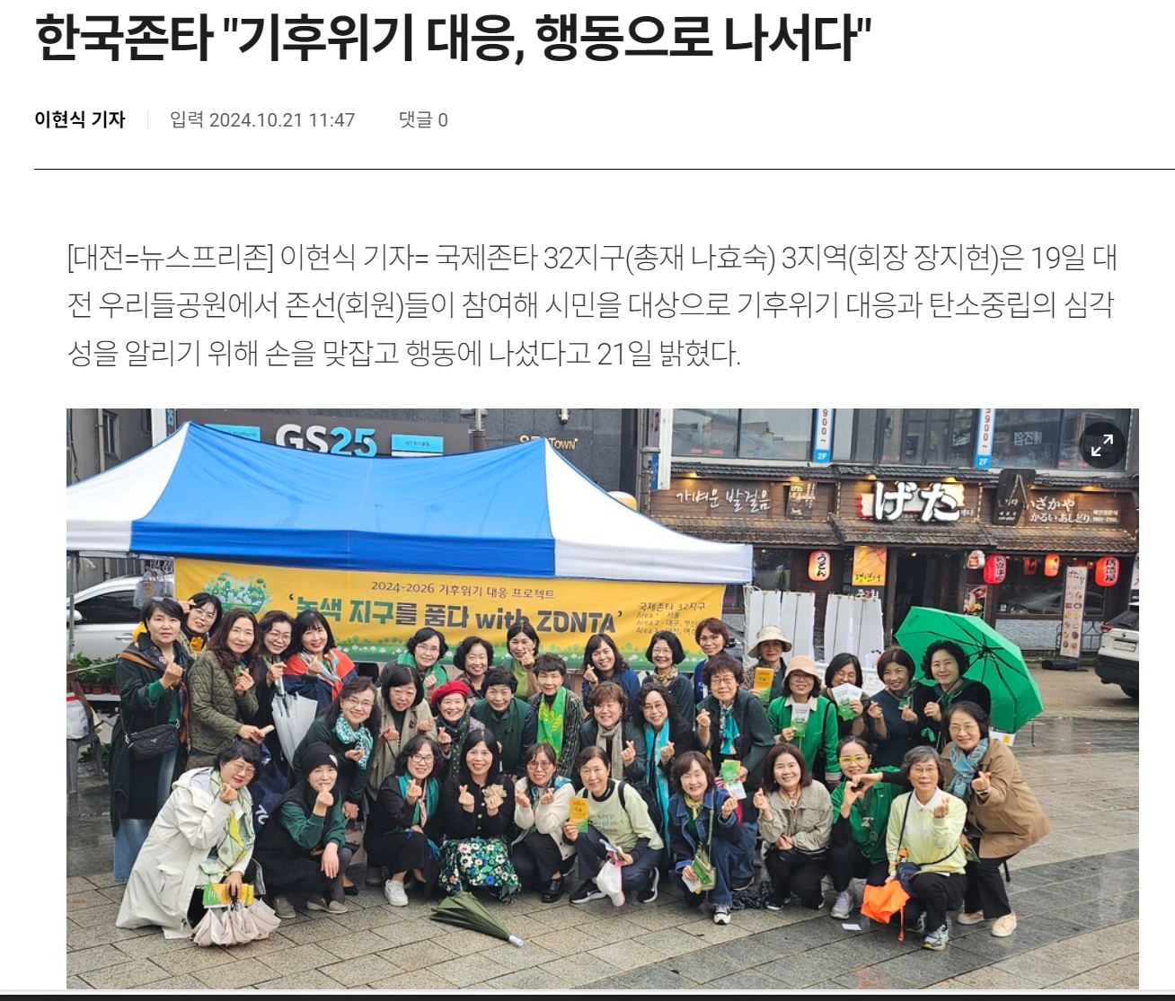
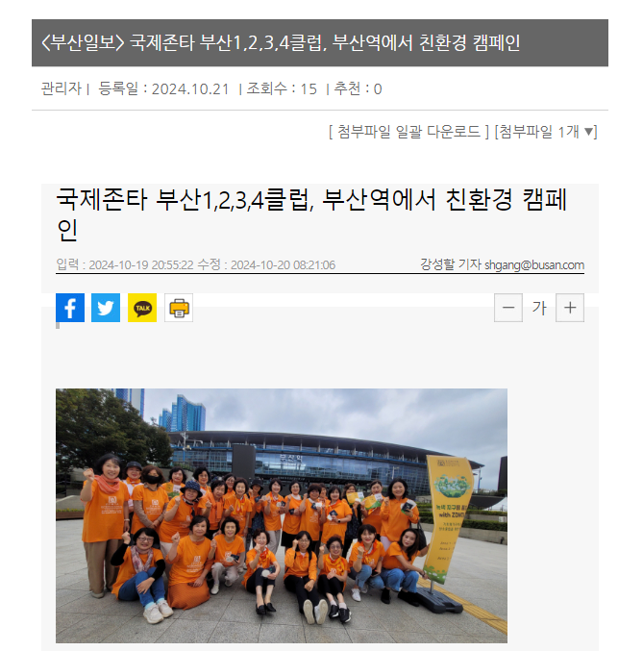
CLIMATE CRISIS RESPONSE EVENT
Responding to the climate crisis, taking action
Eco-friendly campaign
<Daejeon – Press Release>
<Busan – Press Release>

Slide 22
ZONTA Says no - ADVOCACY (2)
2. Campaign to prevent violence against women
Division | Area 1 | Area 2 | Area 3
Date | 2024. 11. 30 (Sat.) | 2024. 11. 30 (Sat.) | 2024. 11. 30 (Sat.)
Location | Seoul | Daegu, Busan | Daejeon, Yeosu
Attendees | 30 | 50 | 45
Details | Oppose illegal filming, dating violence, workplace harassment, sexual violence, and domestic violence Distribution of leaflets containing information and photos against gender-based violence

Slide 23
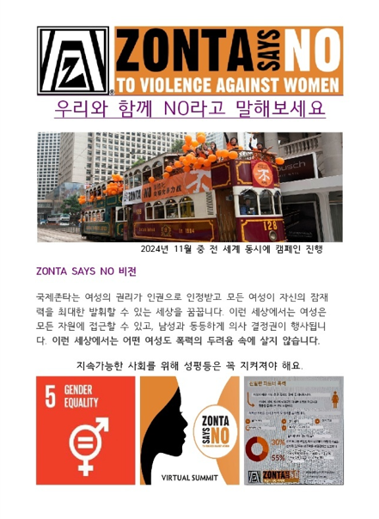
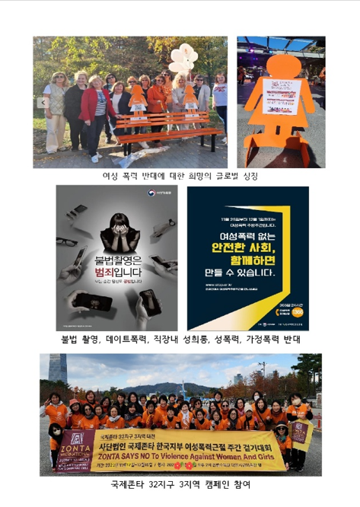
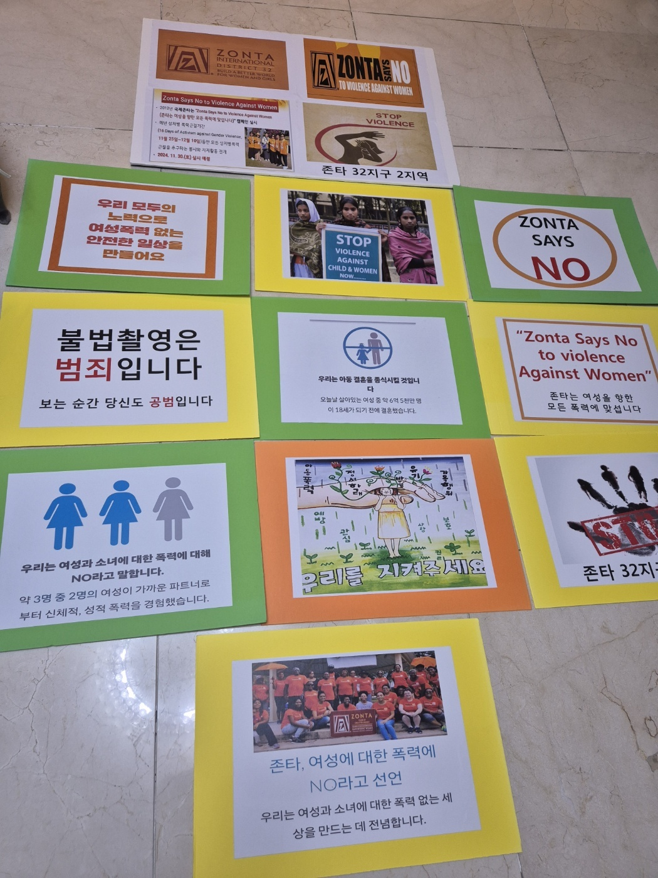
Activity materials
<Leaflet>

Slide 24
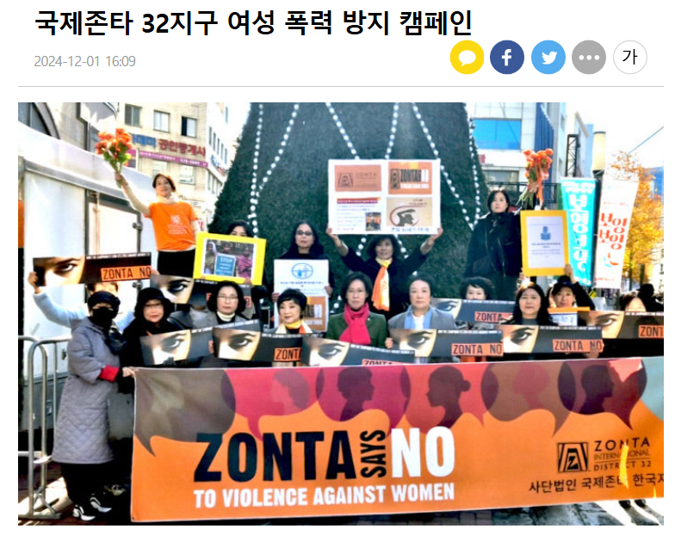
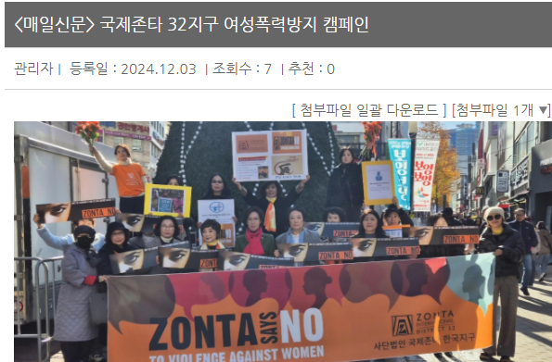
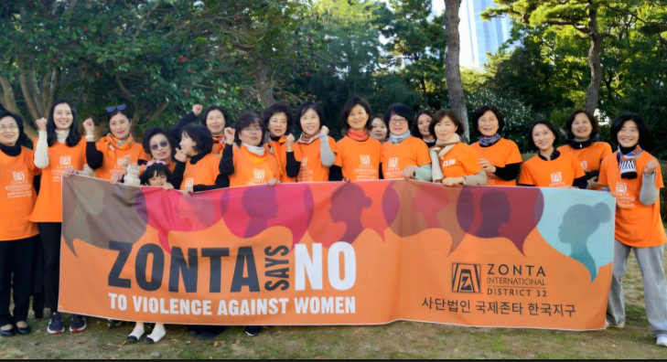
press release (daegu, busan)
Area 2 Prevent Violence Against Women Campaign

Slide 25
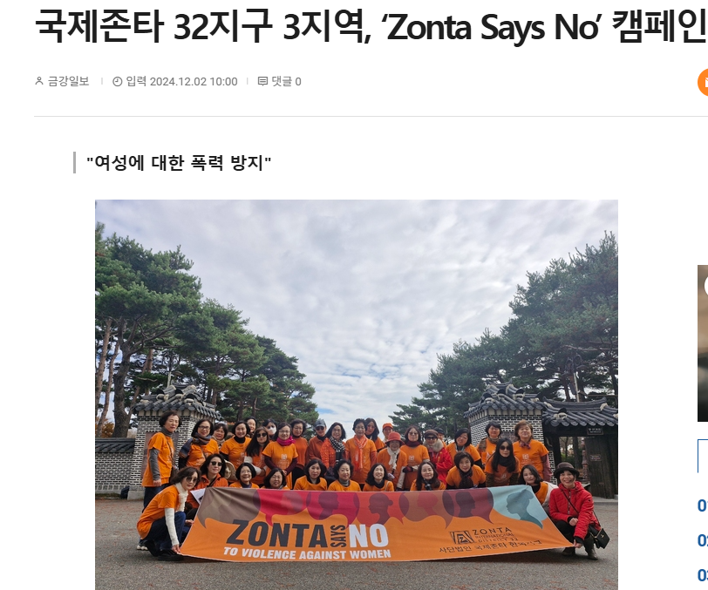
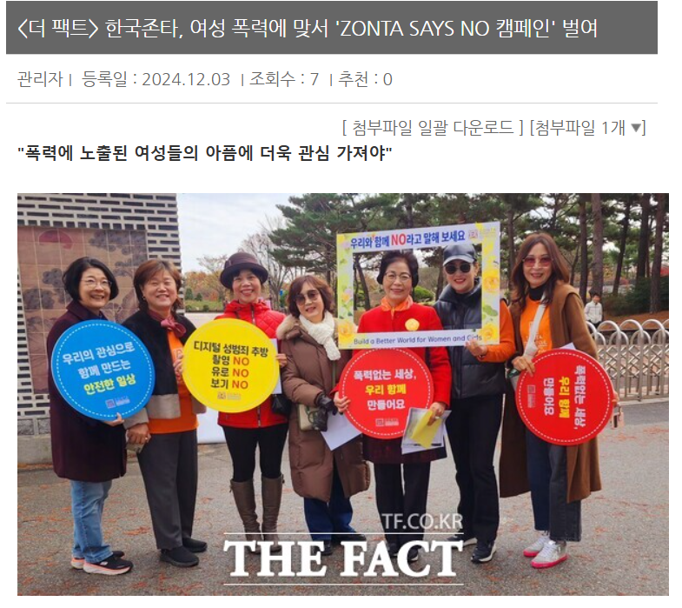
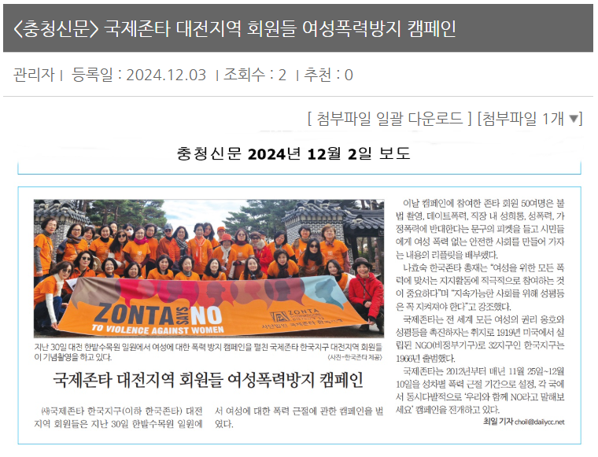
Press release (Daejeon)
Area 3 Zonta Says NO Campaign

Slide 26
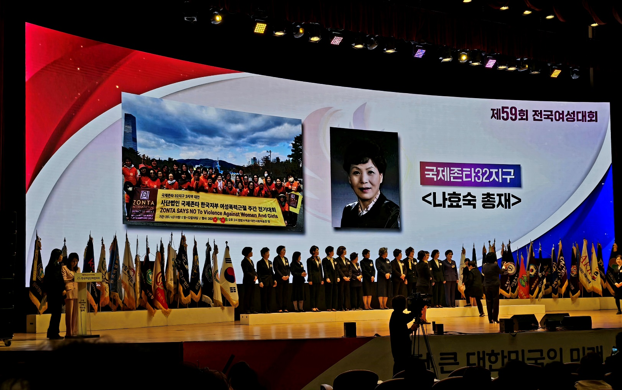
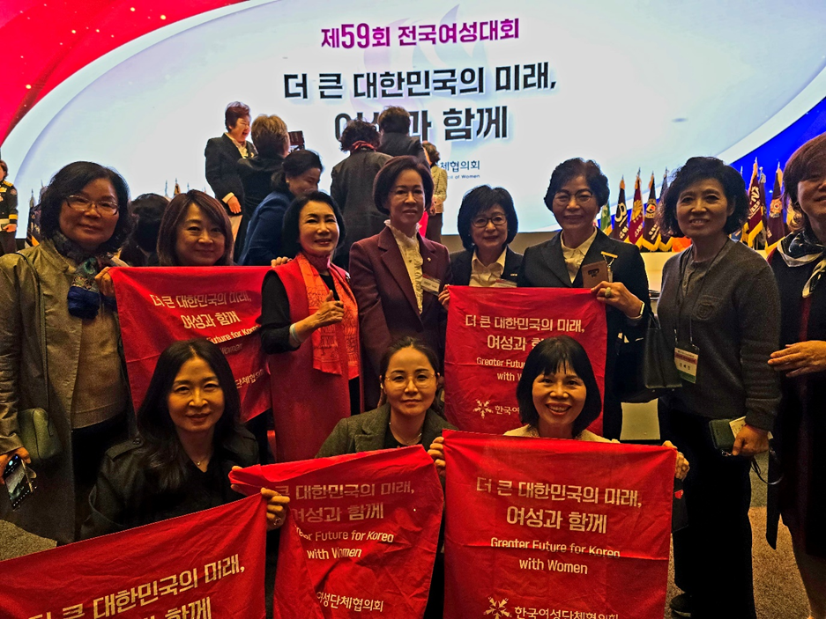
National women’s conference
"The Greater Future of Korea, Together With Women"
Participating in the National Women’s Conference to promote ZONTA’s status

Slide 27
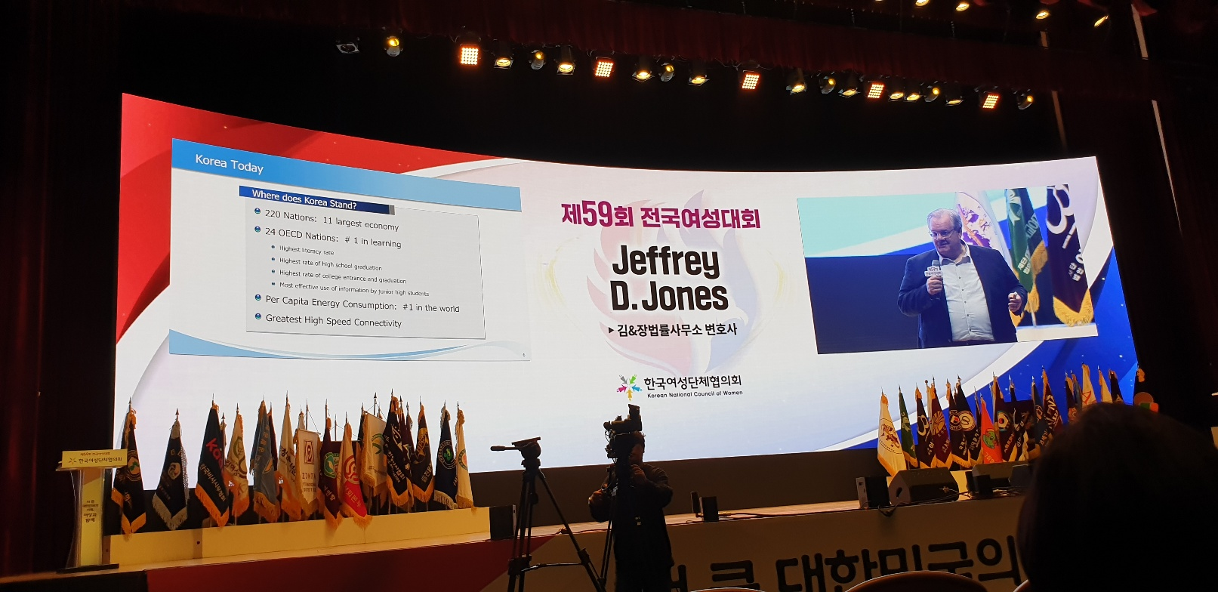
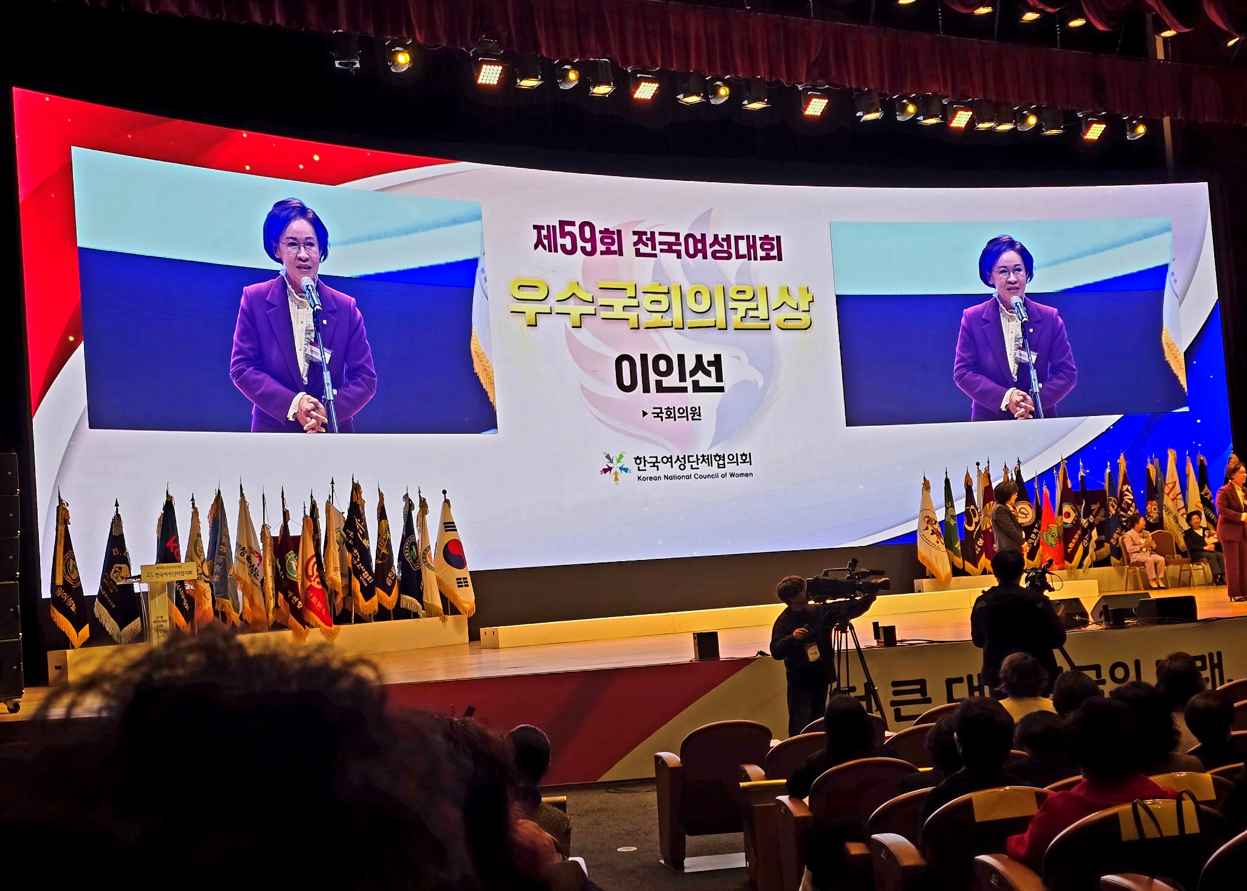
national women’s conference
The Role of Women in Modern Society
Daegu Club II (Lee In Seon Zontian)

