Slide 1
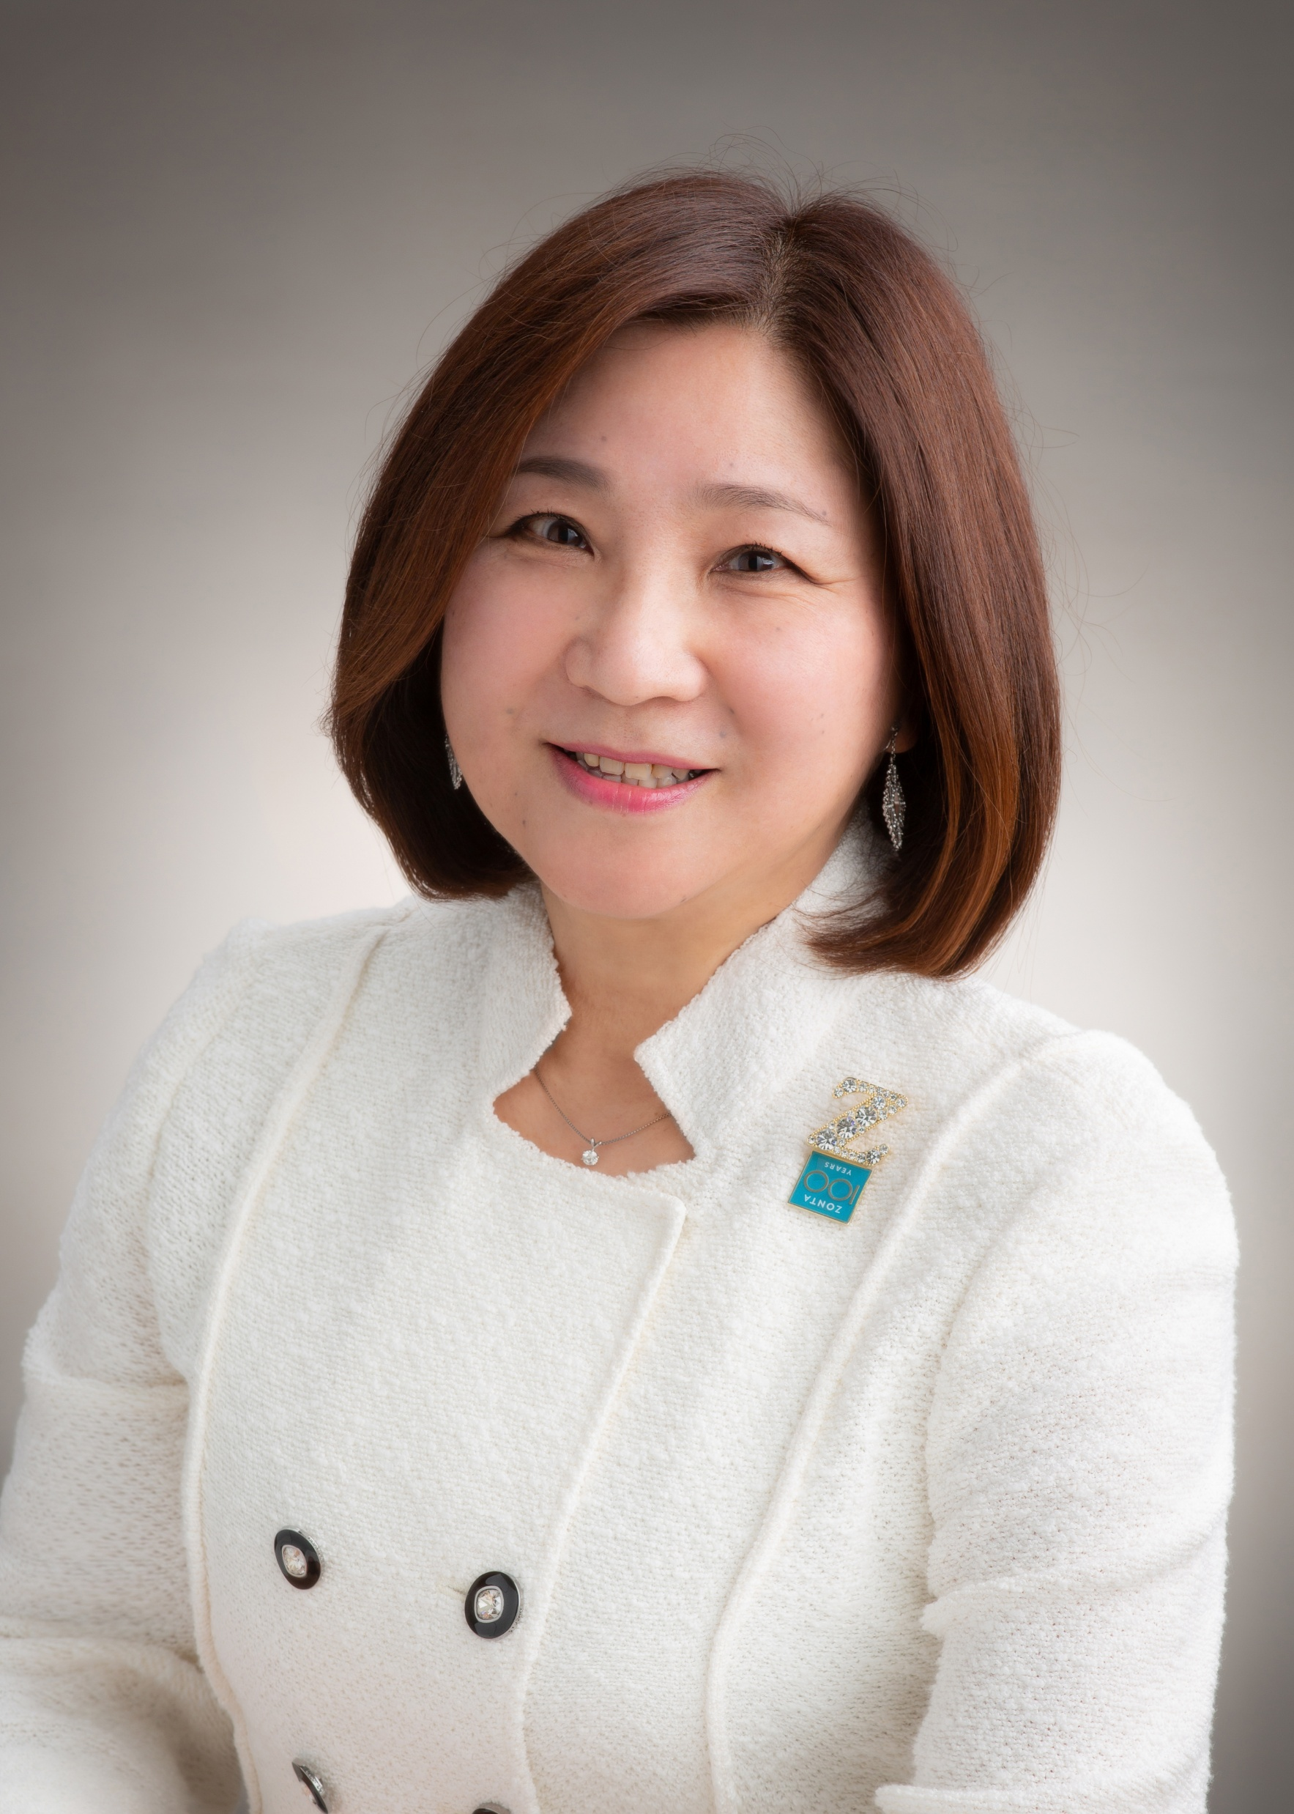
District26 Action Report
MICHIYO WADATSU
District26 Governor

Slide 2
Distribution Map of Clubs and Z & GZ Clubs in District 26
44 clubs 741
Z ＆ GZ 230

Slide 3
Challenges Faced by women in D26(Japan) Report by the Government of Japan (2024)
Household Role Distribution
Labor Market Inequality
Gender gap
Low political participation
Social prejudice and discrimination
Growing Expectations for Zonta

Slide 4
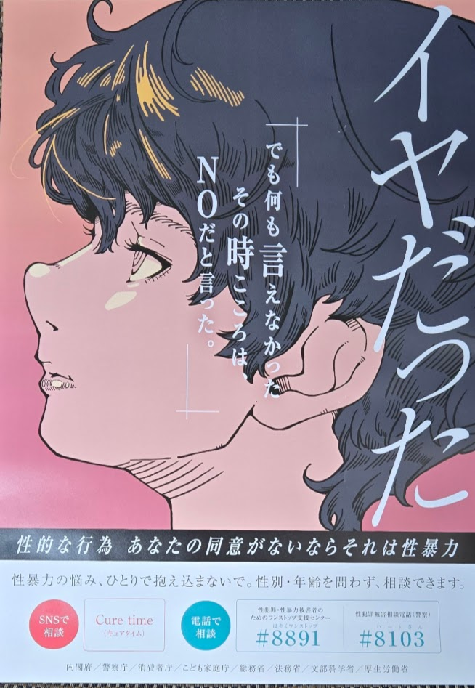
Collaboration with the Japanese government and UN-Affiliated organizations at the district level
Cooperation with the Cabinet Office
Recognized as a member of the Collaborative Council for the Promotion
of Gender Equality under the Gender Equality Bureau of the Cabinet Office.
Working on gender issues among young people as a member of
the Youth Gender Role Awareness Team.
Collaboration with Unwomen Japan Association
As an association member, we promote gender equality by sharing information.
Sexual Violence Prevention Month for Young Adults (April)

Slide 5
District 26 Domestic Service Report 2022-2024
Educational Support
1. Donation of books to libraries and educational institutions
2. Clubーsponsored scholarship program
3. Study assistance for foreign children, etc...
Community Service
1. Support for DV shelters
2. Support for children's cafeterias, etc...
Starfish Project
District 26‘s original service project, starting in 2021
*Ongoing support tailored to the needs of the communities in which the clubs exist!

Slide 6
Domestic Service Projects 2022-2024
FY2022 : approx. 18 million yen
FY2023 : approx. 20 million yen
(including Noto Peninsula Earthquake Relief Funds)
Many women and girls in Japan are being empowered through the support of Zonta International District 26.
Challenges
Lack of sufficient verification of the actual impact of support
(Need to determine the direction for more effective future support)

Slide 7
Natural Disasters in Districts 26
2011: Great East Japan Earthquake
Establishment of “Yamada-cho Zonta House” as District 26, with support from Zontians.
Provided a “place” for children affected by the disaster for 10 years, allowing them to concentrate on their studies and receive psychological care.
2024: Noto Peninsula Earthquake
The Zonta Club of Kanazawa , based in the disaster-affected area, continues to provide logistical support to a local organization that supports women and girls who are unable to receive public .aid
Thank you all for your tremendous support and heartfelt sympathy!

Slide 8
Join Hands, Unite Hearts, Pass the Baton of Zonta to the Next Generation! D26 Slogan and District Operations for 2024-2026 (All members, clubs, and areas should embrace this slogan!)
Collaboration with other organizations
（Rotary Clubs, Lions Clubs, Soroptimist, and other NGOs, as well as with educational institutions and communities）
Collaboration in district administration
Coordination of the Awards and Scholarships Chair Team
（Simultaneous dissemination of the Zonta Education Program）
Collaboration between the Service and Advocacy Committee
（Review and update of District Starfish Project )

Slide 9
Thank you for listening. The next Speaker is Lieutenant Governor Wakiko. I now pass the baton to her.

