Slide 1
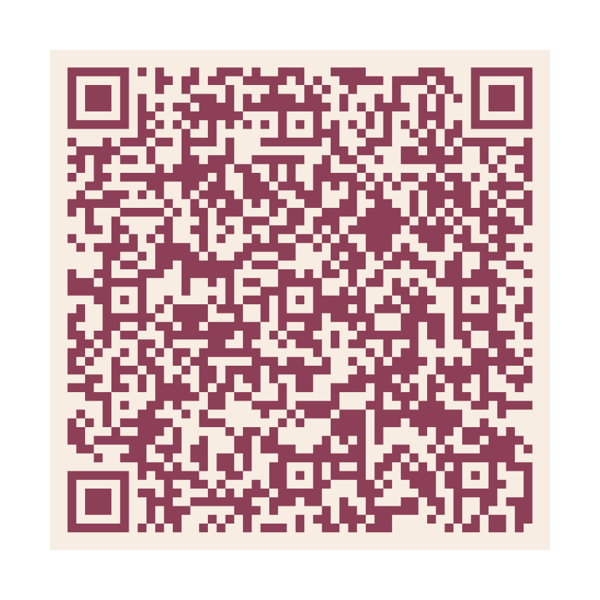
40
YEARS
BUILDING A BETTER WORLD
BEGINS WITH A STRONG FOUNDATION
www.zonta.org/Foundation40

Slide 2
40
YEARS
BUILDING A BETTER WORLD
BEGINS WITH A STRONG FOUNDATION
www.zonta.org/Foundation40

